Slide 1


MARTINAIRE PILOT
SECURITY TRAINING

Slide 2
MARTINAIRE / TSA DSIP COMPLIANCE
The requirements of this program are considered:
“SENSITIVE SECURITY INFORMATION”. Under 49 CFR 1520 – Protection of Sensitive Security Information.
NEED TO KNOW ONLY. This information cannot be passed on to the public.
Martinaire is required to implement certain procedures or instruction to the contract aircraft operator as result of governmental regulation. Failure to comply with these regulations could result in the issuance of a ‘Letter of Investigation’ (LOI) by a TSA inspector and has a maximum potential fine of $25,000 per violation or infraction.
Transportation Security Regulation (TSR) 1540.105 states that individuals can be held personally liable for each infraction with a maximum potential fine of $2,500 for each of those infractions. (That means YOU, the pilot)

Slide 3
MARTINAIRE / APPLICABILITY
The requirements of this program apply to all contract aircraft operators, that transport and handle air freight on behalf of customers such as UPS.

Slide 4
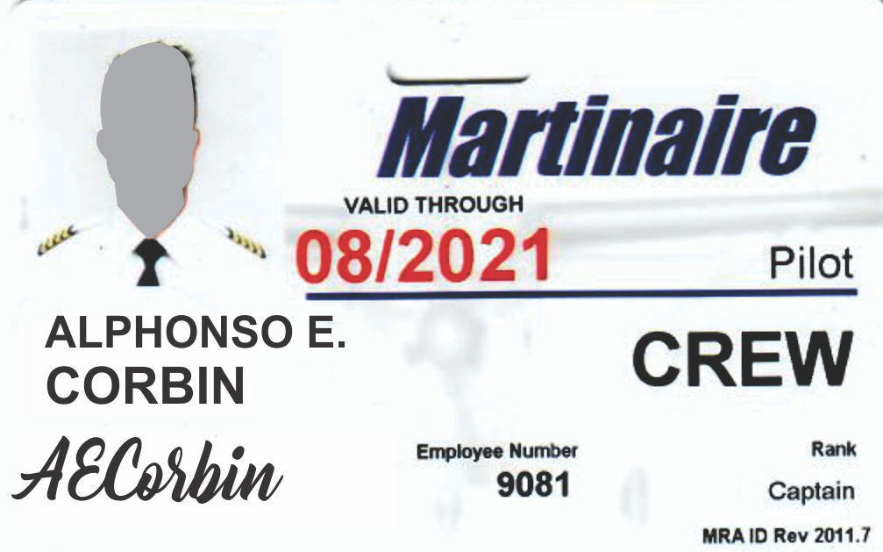
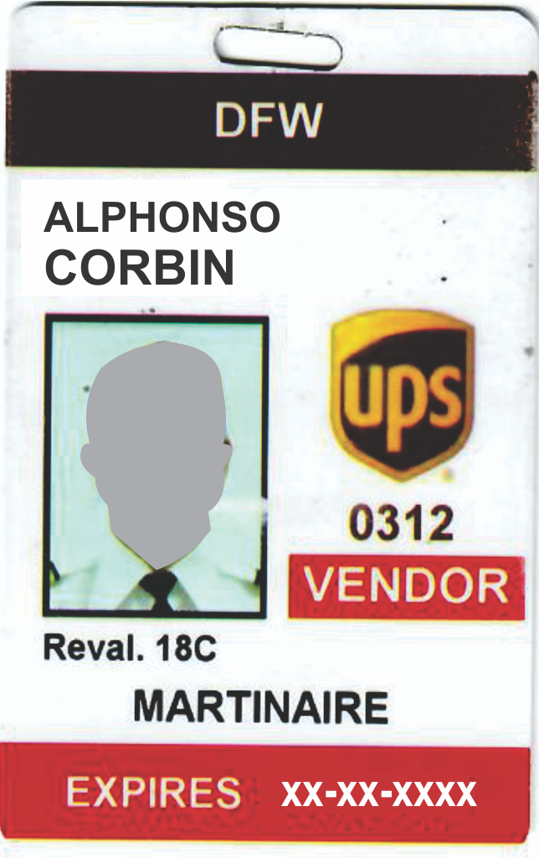
MARTINAIRE / APPLICABILITY
Unless under authorized escort, Martinaire employees on airport property shall, at all times, wear at waist level or above so as to be readily visible, an airline/airport-issued or airline/airport approved identification medium.
Martinaire shall ensure that any employee whose identification medium is lost, stolen, or misplaced shall immediately report such loss.

Slide 5

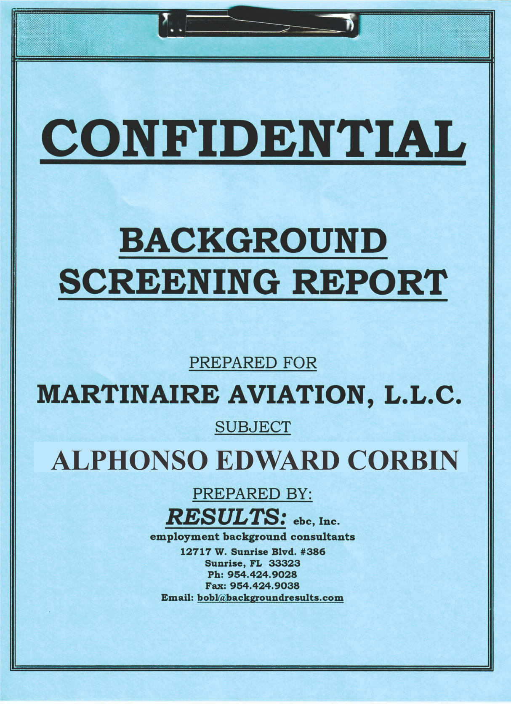
Background Checks
FBI Fingerprint-based Criminal History Record Checks (CHRC) must be performed on all flight crew members pursuant to 49 CFR 1544.229 and 1544.230.
For the individual to serve as a flight crew member, this CHRC must not disclose a disqualifying criminal offense as described in 40 CFR 1544.229(d).
A record of the CHRC must be maintained pursuant to the record maintenance section of 49 CFR 1544.230

Slide 6
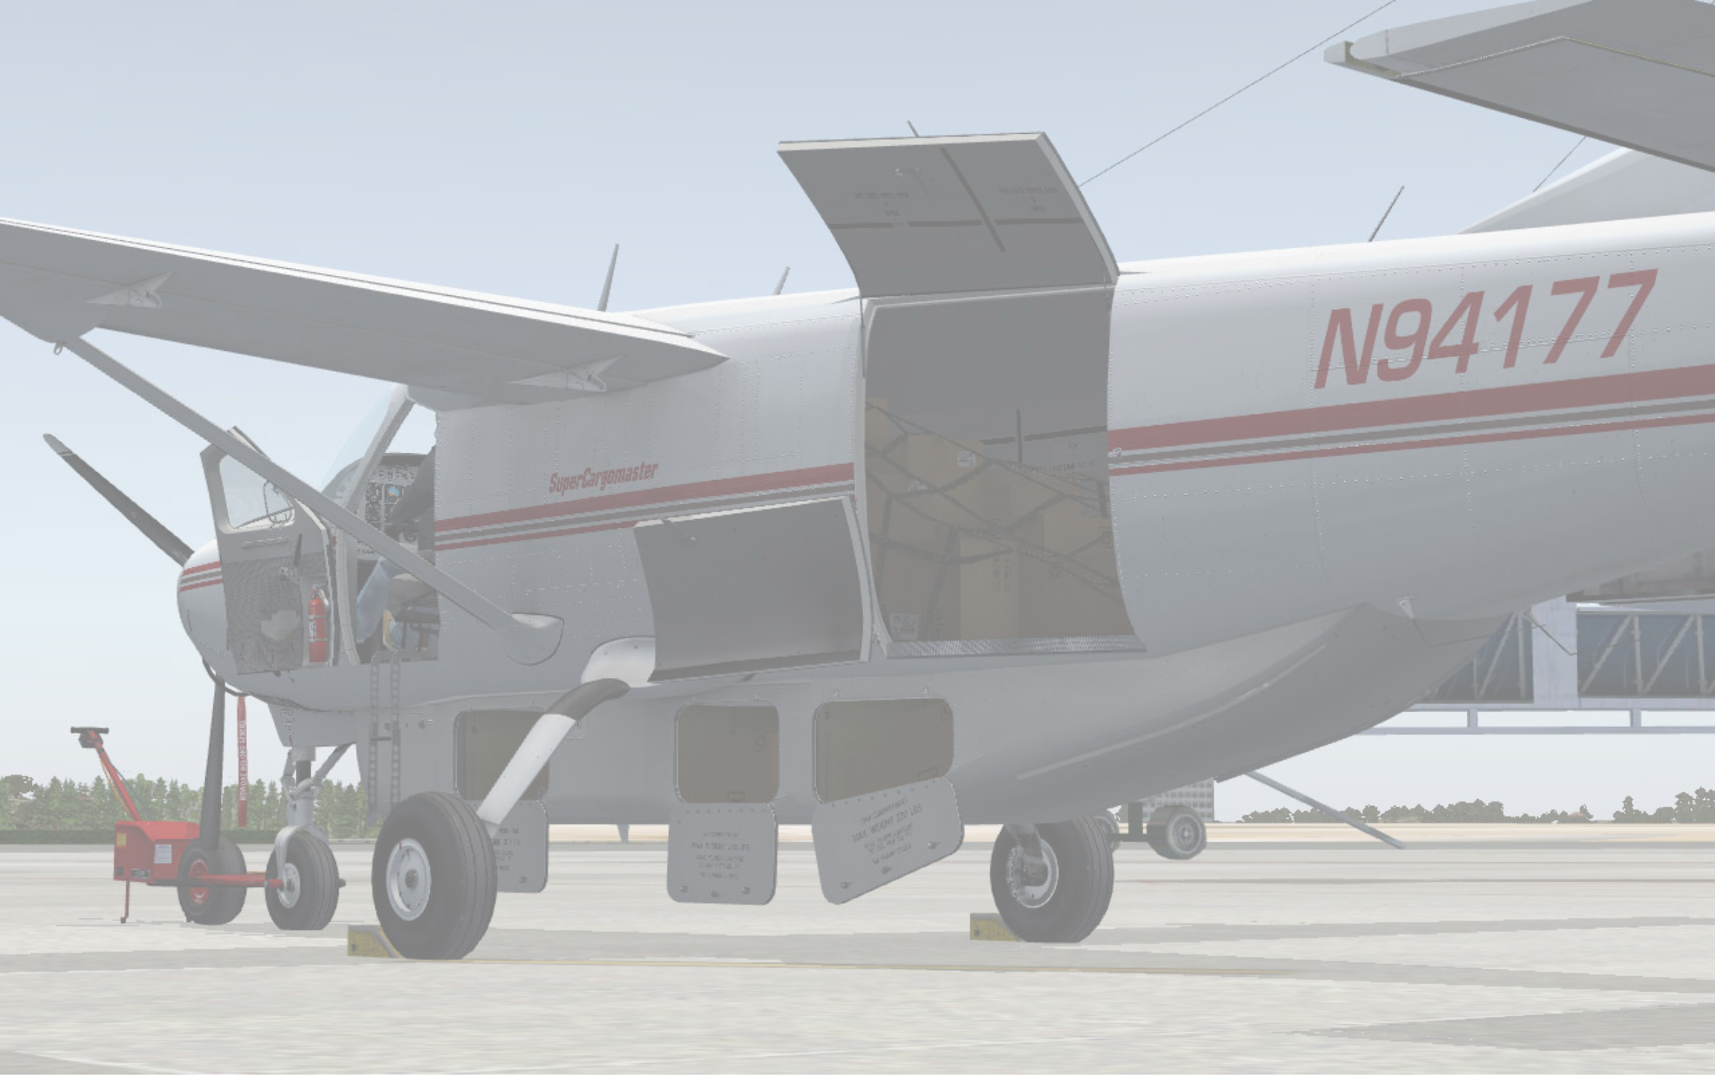
ACCESS TO CARGO & FACILITIES
All Contract Aircraft Operators are responsible for controlling access to cargo in their possession.
All Contract Aircraft Operators must take the necessary precautions to prevent access by unauthorized persons.
Do Not leave the aircraft after loading is complete.
Only customer employees can watch over the loaded aircraft if you absolutely have to leave the vicinity of the aircraft.

Slide 7
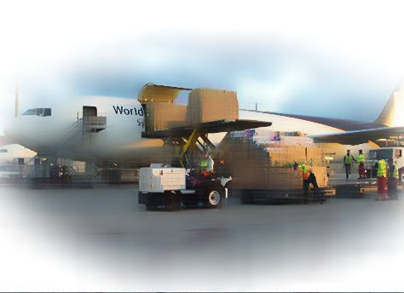
ACCESS TO CARGO & FACILITIES
The UPS Domestic Security Integration Program (DSIP) requires all contract aircraft operator employees working on behalf of UPS, to control access to each of its air operations areas and to its cargo acceptance areas, staging areas, and other non-public areas.
Only individuals that have proper access or who are appropriately under escort are allowed to access the area where UPS cargo is accepted, staged, or in an area considered to be a non-public area.

Slide 8
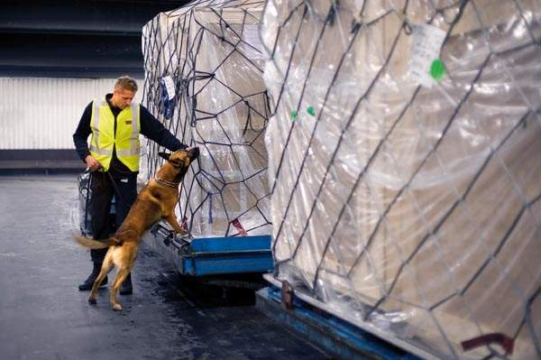
ACCESS TO CARGO & FACILITIES
Only authorized individuals are
allowed access to Cargo areas.
Doors, gates, fences, etc., must be in good repair and secured to prevent unauthorized access to the cargo areas.
Signs stating authorized access only should be posted as a warning to the public not to enter the area.
Enunciators can also be used to alert the contract aircraft operator’s staff to the entrance or exit of a person.

Slide 9
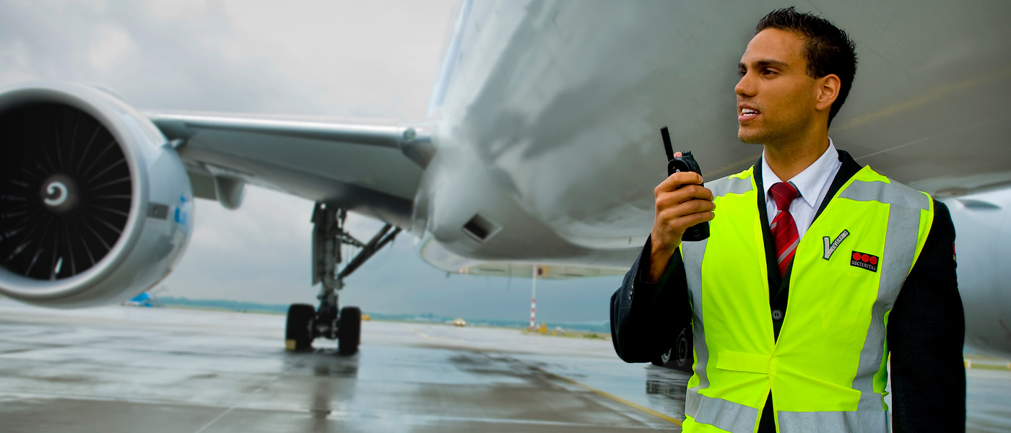
Challenge Procedures
Discovery of someone in cargo acceptance areas, staging areas, or non-public areas must be challenged. You may ask “May I help you?” or “May I see your ID?”
Should you discover an unauthorized person at major UPS facilities, notify an appropriate UPS ramp manager.
Remember! It might be a TSA agent testing your response! (This could cost you $2500!)

Slide 10
Aircraft Search
All aircraft being used exclusively for the transportation of merchandise, goods, mail, and cargo, will be searched prior to loading of the aircraft by a flight crew member to ensure nothing prohibited has been introduced to the aircraft or cargo to be transported.
Aircraft will again be searched after unloading to ensure nothing is left behind and nothing prohibited was introduced to the aircraft or cargo being transported.

Slide 11
Aircraft Readiness
Check you plane (including cargo pods) prior to and after loading!
All contract aircraft operators must ensure that all cargo is properly documented and no unauthorized cargo has been placed in the shipment.

Slide 12
Aircraft Readiness
Procedures for loading and unloading the
aircraft come from the Vendor’s Operating
Specifications and have been adopted by
Martinaire. These procedures shall be
followed by all Martinaire pilots without
Exception.

Slide 13
Aircraft Readiness
All Contract Aircraft Operators are required to comply with all UPS procedures concerning the acceptance and handling of cargo as provided by UPS Management, including proper completion of all documents required under the TSA DSIP.
For Martinaire, this includes completion of Weight and Balance; transmission and proper completion of the NoPC for any HAZMAT being carried; acceptance of any ‘Special Use Permits’ supplementing a HAZMAT shipment; and the checking and acceptance of a UPS Load Manifest for the involved flight.

Slide 14

Bomb Threats
Martinaire shall take the applicable actions in response to bomb threats that are directed against a specific aircraft and in response to bomb threats that are directed against specific ground facilities located on an airport.
All specific and nonspecific bomb threats must be immediately (as practical) reported to MARTINAIRE Dispatch (who will then notify the customer.
If a bomb threat is against a specific aircraft, MARTINAIRE shall initiate inspection action as appropriate and inform the affected airport.

Slide 15
Bomb Threats
If an inspection is required, conduct the inspection on the ground before the next flight, or if the aircraft is in flight, immediately after its next landing. If the aircraft is being operated on the ground, the pilot-in-command (PIC) shall submit the aircraft for security inspection. If the aircraft is in flight, the PIC will take the necessary emergency action necessary under the circumstances, and land as soon as practical.

Slide 16
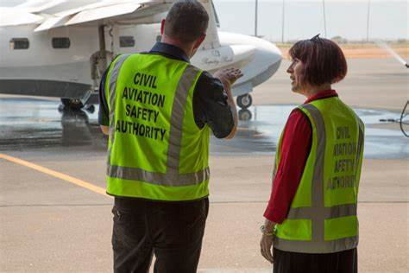
TSA / FAA Inspections
If the contract aircraft operator is approached by any government official, it is the responsibility of the contract aircraft operator to notify UPS (via MARTINAIRE Dispatch) of the event and the circumstances surrounding it.

Slide 17
END

